Slide 1

WHOA THERE!
DELETE THIS SLIDE BEFORE PRESENTING
Copy these slides to your Google Drive Account or download as a Powerpoint File.
Customize the wifi info and introduction slides.
Rehearse this presentation at least 1 - 2 times before the workshop.
Notes:
Make sure you delete this slide after following the instructions!

Slide 3

[Put your Photo Here]
Welcome! My name is
[INSERT YOUR NAME].
1
I’m here to lead this session & help you learn something new today!
2
I’m a [LEVEL OF STUDY] at [SCHOOL].
3
My favorite programming language / tool is [LANGUAGE OR TOOL].
Notes:
What to Edit:
Add your name, photo, school information, and favorite programming tool or language.
What to Do:
Make attendees feel welcome by running a short ice breaker. You can use the one below or create your own!
Go around the room and ask each person to answer the following questions:
Who are you?
What year are you in school and what is your major/field of study?
What is your favorite programming language or tool?
You should go first to demonstrate the exercise and introduce yourself.

Slide 4


Welcome to
MLH Localhost - Blockchain Basics: An Introduction to Quorum®, created by J.P. Morgan
Wi-Fi Network:
[Network]
Wi-Fi Password:
[Password]
Event Hashtag:
#MLHLocalhost
Twitter Handle:
@MLHacks
Notes:
What to Edit:
Update this slide to include the Wi-Fi information. If there are special instructions on how to connect to the Wi-Fi in your location (such as needing to agree to terms), add that information to the slide above.
What to Say:
Explain how to connect to the Wi-Fi.
Encourage participants to post photos on Facebook, Twitter and Instagram using the hashtag #MLHLocalhost
What to Do:
Check that everyone is connected by asking the group if anyone is still trying to connect. Go around and help everyone get connected.

Slide 5
Using your Web Browser,
Open this URL & Fill out the Form:
Afterwards, Check your Email to Find:
1
http://mlhlocal.host/checkin
2
Setup Instructions
An Invite to the MLH Slack
The Code Samples
A Workshop FAQ
These Workshop Slides
More Learning Resources
Notes:
What to Say:
Tell attendees they are going to check in for the event. Emphasize the importance of checking in!
Once attendees check in, they will receive an email with the items listed on the slide.
What to Do:
Confirm that everyone has checked in by asking participants if anyone has not yet received the email from MLH. Tell them to check their spam. The subject line will be

Slide 6

Our Mission is to Empower Hackers.
65,000+
HACKERS
12,000+
PROJECTS CREATED
400+
CITIES
We hope you learn something awesome today!
Find more resources: http://mlh.io/
Notes:
What to Say:
Major League Hacking (MLH) events are meant to bring hackers together so they can learn, build, and share.
Give participants a brief overview of Major League Hacking (MLH).
Tell participants they can learn more at http://mlh.io/
Example Talking Points:
TODO
Through Localhost MLH is rethinking technology education to reflect how hackers actually learn and how fast the industry moves.
Here’s some quick facts about MLH:
Each year, MLH supports over 65,000 hackers around the world at events they facilitate
Those students create more than 12,000 amazing projects together
MLH is a global organization that empowers hackers in more than 400 cities and growing every day

Slide 7
What will you learn today?
The basics of Quorum®, an Ethereum-variant developed by J.P. Morgan
1
The basics of Solidity, the language created for Smart Contracts
2
How to run a Quorum® app locally
3
Notes:
What to Say:
Explain to participants what they will learn today
Learning is a core part of being a hacker and today they are going to learn something new
What to Do:
Get participants excited about the experience.
Ask if any of them have heard of

Slide 9
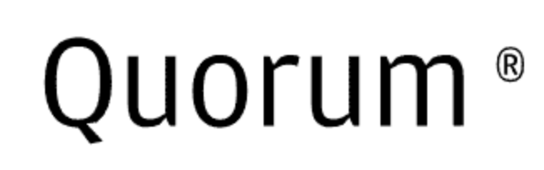
What is Quorum?
Quorum is a fork of the Ethereum blockchain based on the Go Ethereum implementation, developed by J.P. Morgan.
Quorum is open source.
Quorum supports private transactions while maintaining network transparency.
Key Term
distributed ledger protocol: a system of verifying and maintaining financial transactions in which the database of transactions (ledger) is held independently by each node (participant) in a large network of different actors (distributed)
Notes:
What to Say:
Read the slide.
What to Do:
Ask if anyone has heard of Ethereum or distributed ledgers before. Encourage a short knowledge-sharing discussion.

Slide 10

What is Ethereum?
Ethereum is the generalized blockchain for smart contract development.
Ethereum is not just a cryptocurrency - it is also a platform for developing decentralized applications.
Quorum is built on top of Ethereum, the platform.
Key Term
cryptocurrency: digital currency in which transactions and units of currency are verified by encryption techniques; cryptocurrencies do not require a central banking organization but rather a peer-to-peer network to oversee it
Notes:
What to Say:
Read the slide.
Emphasize that Quorum is not a cryptocurrency. It's a ledger and smart contract platform.

Slide 11
What is a decentralized application?
A decentralized app (DApp) is an application where computation is done by multiple nodes hosted in different places.
Most of the applications you are used to working with are organized, maintained, and controlled by a single entity (the server) and share information with other entities that request it (you - the client).
Decentralized applications operate on peer-to-peer networks (P2P), an architecture in which the rights and responsibilities of creating and maintaining an application are split amongst different actors in a group. This is why they're called decentralized.
Key Term
node: any device (such as a computer) connected to a network
Notes:
What to Say:
Read the slide.
What to Do:
Ask if anyone has interacted with any decentralized apps before. Get a general feel for the audience's comfort. This will help you determine how quickly to work as you move forward.

Slide 12
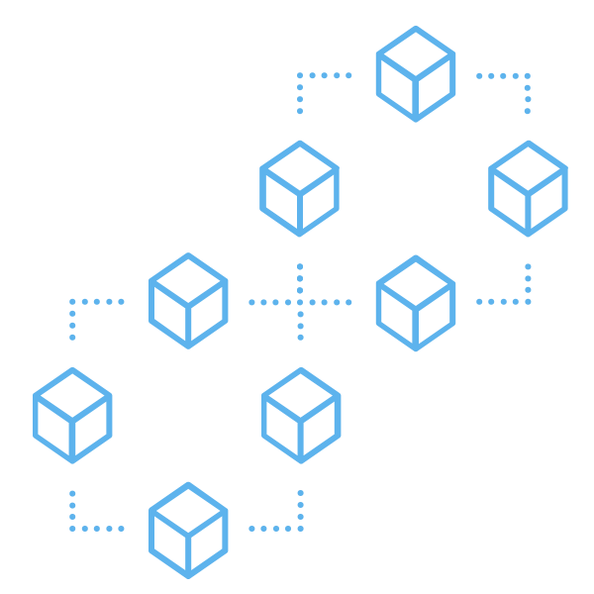
What is a blockchain?
A blockchain is a digital ledger where transactions are recorded.
Transactions are recorded chronologically.
Many blockchains are public.
Transactions are verified by many nodes in the P2P network - this is why digital currencies and other transactions recorded via blockchain are so secure.
Notes:
What to Say:
Read the slide.
What to Do:
Emphasize that there is a difference between digital currencies and the blockchain. The blockchain is a way of recording transactions and information; digital currency is currently the most frequent use case but is certainly not the only one.

Slide 13


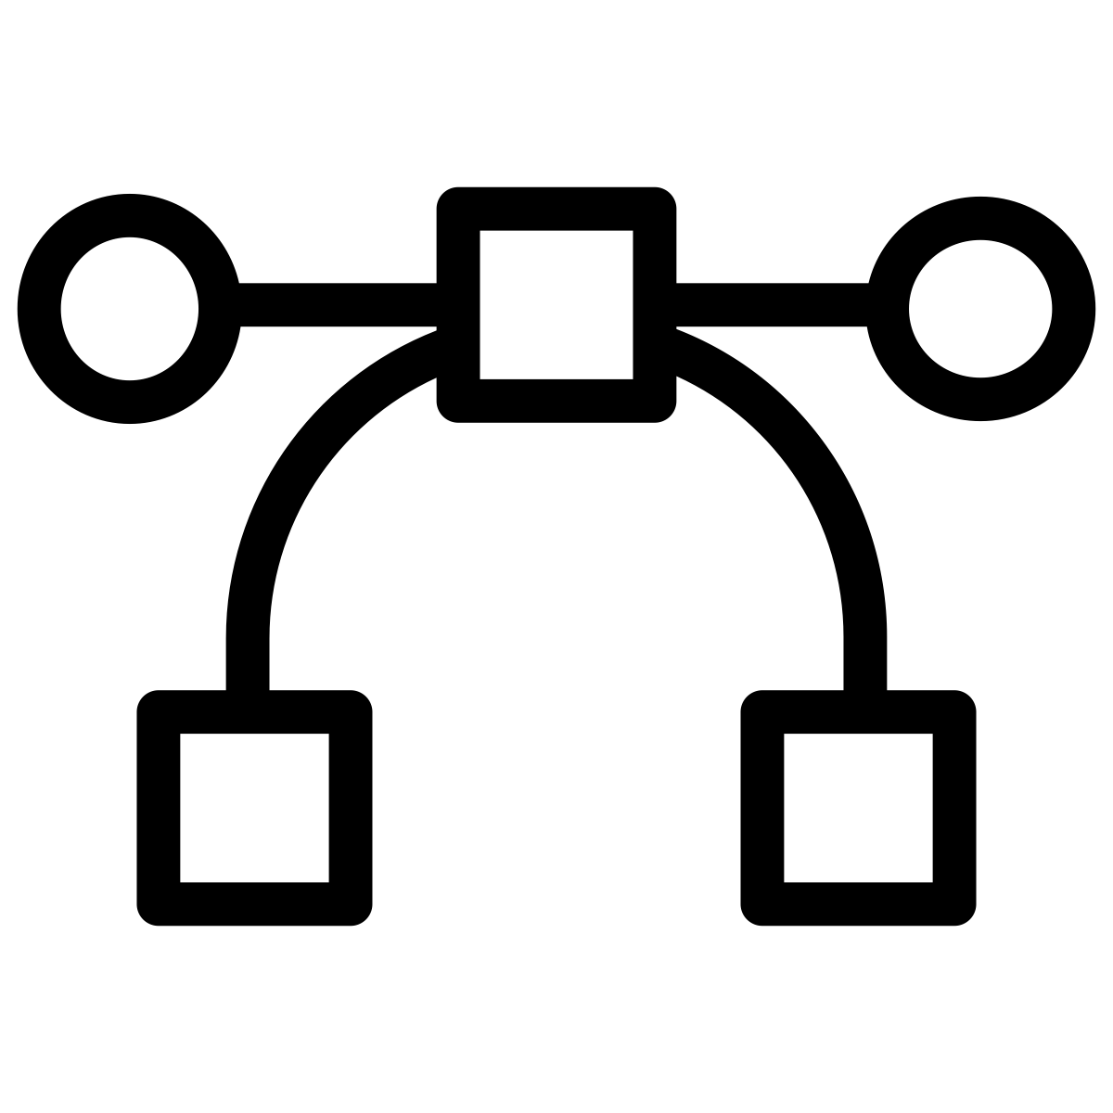

Quorum build on top of Ethereum
There are three primary features of Quorum that extend Ethereum.
Private Transactions and Contracts: Quorum adds a privateFor parameter to the Ethereum Transaction Model.
Network Permissioning: Quorum adds a feature that controls which nodes can connect to other nodes.
Higher Performance due to new Consensus Mechanisms: Quorum replaces traditional Proof of Work consensus with IBFT and RAFT consensus algorithms which are much faster.
Notes:
Useful Notes: Private Transactions: Supporting private transactions and private smart contracts are important of sensitive information. Quorum was built for financial institutions where the privacy of information is incredibly important.
Network permissioning: Supports permissioned nodes so that institutions can control who has access to their transactions
Higher Performance: Supports more transactions per second that traditional ethereum clients because of difference in consensus mechanisms. Focus on supporting enterprise use cases.
Consensus Mechanisms: Quorum replaces the traditional Proof of Work (POW) and Proof of Stake (Proof of Stake) mechanisms with a Raft-based consensus mechanism (https://raft.github.io/) for supporting distributed systems. It also supports a PBFT-inspired consensus algorithm called Istanbul BFT (https://github.com/ethereum/EIPs/issues/650).

Slide 14
The Transaction Life Cycle Part I
A Sender submits a transaction to their node. The transaction’s payload should specify which parties it is privateFor.
The Sender’s node passes the transaction to their Transaction Manager.
The Transaction Manager makes a call to its Enclave to validate the Sender of the transaction.
Key Terms
Payload: The information sent with a request or transaction.
Transaction Manager: a node that passes transaction information between parties.
Enclave: a node that verifies the authenticity of a transaction.
Notes:
What to Say:
Read the slide.

Slide 15
The Transaction Life Cycle Part II
The Enclave validates and encrypts the transaction’s payload.
The Enclave performs the Transaction Conversion, a series of steps that returns necessary information to the Sender’s Transaction Manager.
The Sender’s Transaction Manager passes all of this information to the Receiver’s node via HTTPS.
The Receiver responds with an Ack or Nack response. If the response is Ack (affirmative), the transaction is propagated to the network.
Notes:
What to Say:
Read the slide.

Slide 16
The Transaction Life Cycle Part III
A block that contains the information from previous steps is created and distributed to all nodes.
All nodes on the network all attempt to process the Transaction. However, only nodes specified in the privateFor parameter are authorized to process it. These nodes make a call to their Enclaves and pass the information to it.
Each node’s Enclave validates the signature and decrypts the transaction’s payload and returns it to the transaction manager.
Key Term
signature: a private key that establishes identity, akin to an account number
Notes:
What to Say:
Read the slide.

Slide 17
The Transaction Life Cycle Part IV
The Enclave validates and encrypts the transaction’s payload and returns it to the transaction manager.
The Sender’s and Receiver’s Transaction Managers send the payload to the EVM for contract execution.
The Quorum node’s state is updated, and the transaction is complete.
Key Term
EVM: Ethereum Virtual Machine, the runtime environment for Smart Contracts
Notes:
What to Say:
Read the slide.

Slide 18

What can you use Quorum for?
Quorum has many uses!
Quorum can be used for any service or economic activity.
Currently, these are mainly the exchange of electronic currencies and goods, but the possibilities are endless!
Notes:
What to Say:
Read the slide.
Mention other examples, such as digital medical records!
What to Do:
Pause here and ask participants if any of them have ideas of use cases for Quorum.

Slide 19

Why does this matter?
As it stands, most information on the internet is maintained and distributed by client-server applications.
With decentralized applications, blockchain technology, and advances like Quorum, we can envision a future of the internet in which participants benefit in new ways.
The mission behind decentralized applications is to place the authority with the users instead of a central body.
Notes:
What to Say:
Read the slide.
Now, we're going to use our own decentralized app!
What to Do:
Get participants ready to switch gears.

Slide 20
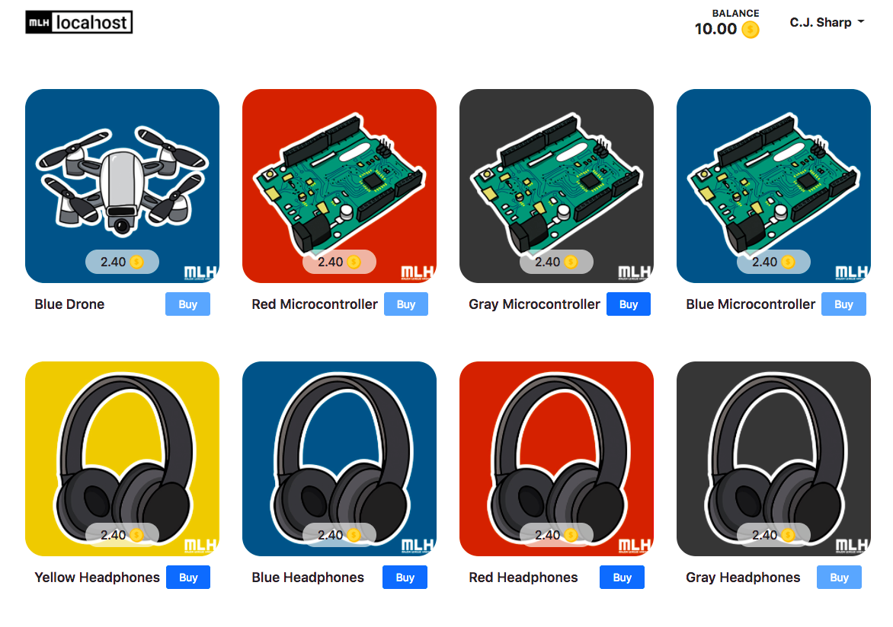
What We’ll Do with Quorum
We're going to run a local Quorum network and use it to buy and sell gear in our TechMarketplace!
Notes:
What to Say:
Read the slide.

Slide 21
Live Version of the DApp
http://mlhlocal.host/quorum-demo
Notes:
What to Say:
Everyone should navigate to the link above and interact with the website listed.
What to Do:
Give everyone a few minutes to play around with the live app before transitioning to the next section.

Slide 23

Prerequisites
This workshop assumes you have some things pre-installed on your computer. Take some time to install them now if you don't.
Install Atom (or your text editor of choice).
1
Install the Atom command line tools (or your text editor's tools). Check out mlhlocal.host/atom-tools for help.
2
Notes:
What to Say:
Read the slide.
What to Do:
Ask participants to raise their hands if they don't have a text editor installed. Be very clear that they should use a text editor for writing code, like Atom, Sublime Text, or the editor of their choice (not Microsoft Word or anything).
If there are participants that do not have a text editor installed, encourage them to install Atom. Ask someone near them to help. They may need to restart their terminal or computer. Be patient and don't move forward until everyone's machine is ready to go!

Slide 24

Environment Setup
There are numerous steps to getting Quorum running on your machine. Some of these will be lengthy! Stick with us. We can also install these simultaneously; once you get one in motion, you can move on to the next.
1
Install Docker
2
Install Node
3
Install Truffle
Notes:
What to Say:
Read the slide.
What to Do:
In order to get a rough estimate of how long this is going to take, ask participants to raise their hands if they do NOT have Docker installed. Then ask if they do NOT have Node installed. Then ask if they do NOT have Truffle installed. This will help you get an idea for how long you will need to spend on this section.
Encourage participants to help each other out with installation. Depending on their individual machines and the way their environments are previously set up, participants might run into trouble. Give them time to work this out - they can't do the rest of the workshop without these things.

Slide 25

What is Docker?
Docker is a platform that helps
developers build, ship and run any application, in any environment.
It’s a way of ensuring that software will continue to work as we expect it to, no matter what hardware or operating system the software is running on.
Notes:
What to Say:
Read the slide.
What to Do:
Emphasize that using Docker makes it much easier to get Quorum running on their local machine, because it creates a container inside of their machine that is pre-setup for them.

Slide 26
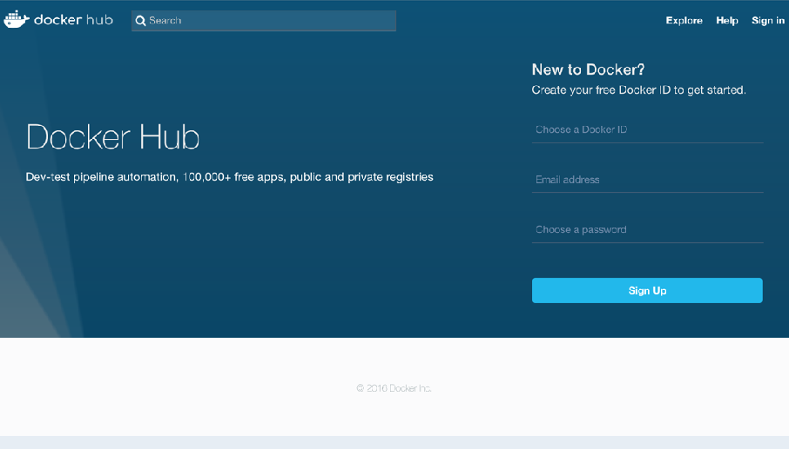
Make a Docker Hub Account
What is Docker Hub?
Docker Hub is a registry of Docker images. You can think of the registry as a directory of all available Docker images. You'll be using this later in this tutorial.
http://mlhlocal.host/docker-hub
Notes:
What to Say:
Read the slide.

Slide 27
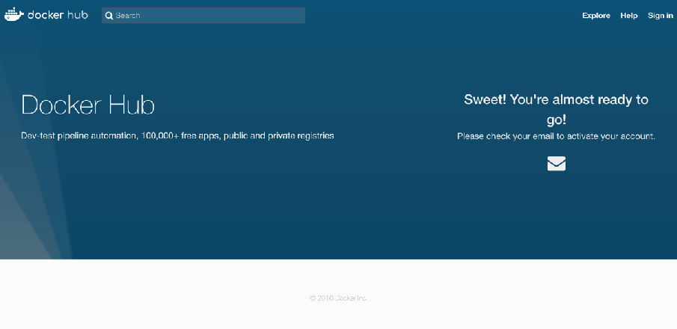
Sign up for a Docker ID
Fill out the Form & Verify your Email Address.
Enter your email and choose a Docker ID and password for your account. You’ll be asked to verify your email address before being able to log in though. Do that now!
http://mlhlocal.host/docker-hub
Note: Remember your Docker ID, you’ll need it later!
Notes:
What to Say:
Read the slide.
What to Do:
Wait for everyone to make a Docker ID if they don't have one already. Again, encourage participants to work together if some are ahead of others.

Slide 28
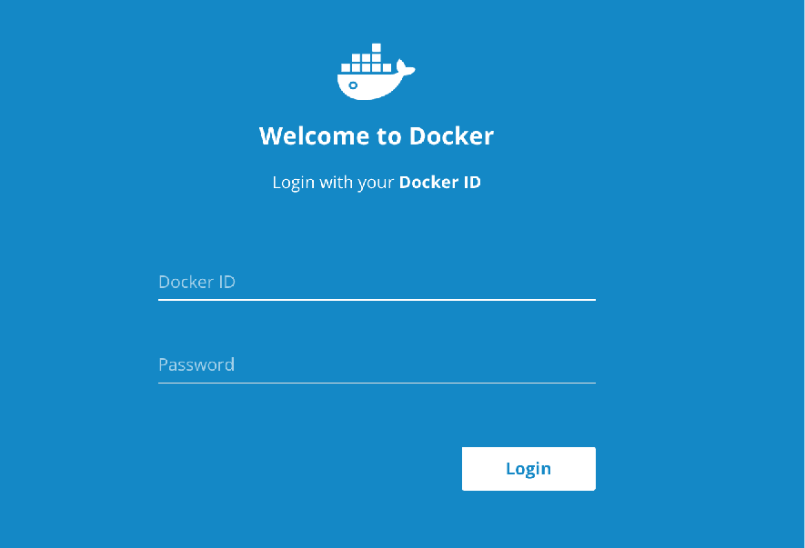
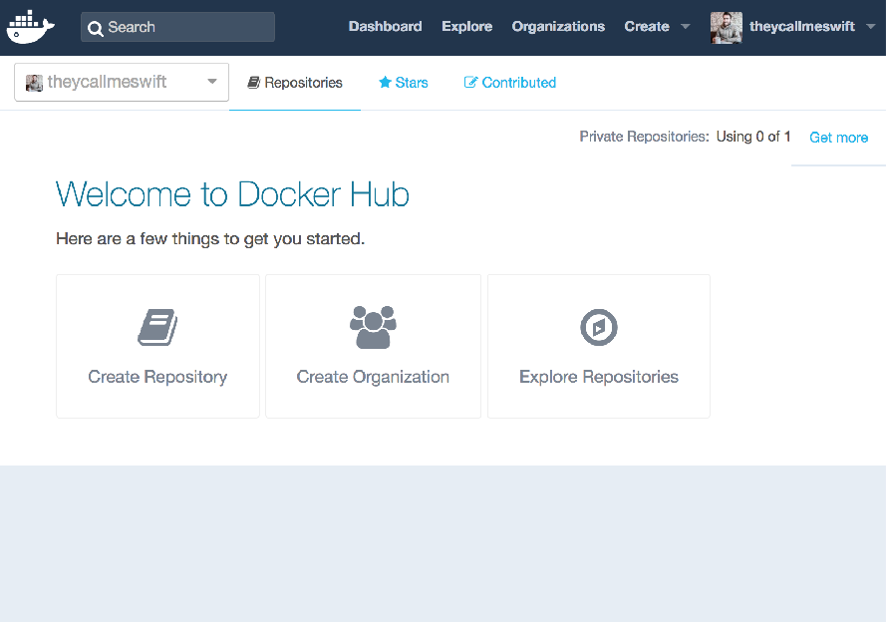
Login Using your Docker ID
Follow the link you got from Docker Hub’s email to verify your account. You can now login using the Docker ID and password you picked!
Notes:
What to Say:
Read the slide.

Slide 29
Let’s install Docker on your Machine!
http://mlhlocal.host/docker-mac
Download for Mac
http://mlhlocal.host/docker-windows
Download for PC
http://mlhlocal.host/docker-linux
Download for Linux
Stuck? Raise your hand & someone will come help you!
Notes:
What to Say:
Navigate to the correct link above, based on your operating system. Begin installing Docker as soon as you find the right version!
What to Do:
Recommend that they use the stable version if you are asked.

Slide 30
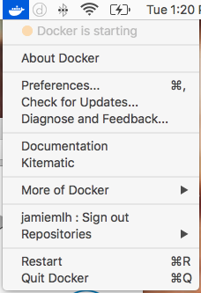
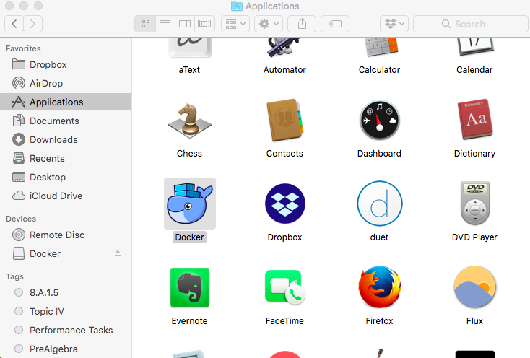
Setting up Docker
Launch Docker
Once you are done installing Docker, open the application on your computer (just like any other app you would use). At the top of your screen, the Docker Logo should be animated.
Notes:
What to Say:
Read the instructions above the command line on the slide.
Troubleshooting:
They also need to know in advance that they should have a shell installed (like Terminal on a Mac or PowerShell on a PC).
If hackers choose to follow the optional command at the bottom of the message, they can type “exit” to get out.
Must be run in administrator mode (log into an administrator user account; or close Docker, right-click on program, ‘run as administrator’).
If they get this error: "Cannot connect to the Docker daemon at unix:///var/run/docker.sock. Is the docker daemon running?" that means they need to open Docker on their machine, just like any other application.

Slide 31
Setting up Docker
Login to Docker Hub
Login to Docker by running the following commands in a command prompt (Terminal, PowerShell, etc):
$ docker --version
Docker version 18.03.1-ce, build 9ee9f40
$ docker login
Login with your Docker ID to push and pull images from Docker Hub. If you don't have a Docker ID, head over to https://hub.docker.com to create one.
Username: ******* Password: *******
Login Succeeded
$
Notes:
What to Say:
Read the instructions above the command line on the slide.
Troubleshooting:
They also need to know in advance that they should have a shell installed (like Terminal on a Mac or PowerShell on a PC).
If hackers choose to follow the optional command at the bottom of the message, they can type “exit” to get out.
Must be run in administrator mode (log into an administrator user account; or close Docker, right-click on program, ‘run as administrator’).
If they get this error: "Cannot connect to the Docker daemon at unix:///var/run/docker.sock. Is the docker daemon running?" that means they need to open Docker on their machine, just like any other application.

Slide 32

What is Node.js?
Node.js is an environment that runs JavaScript code on the server-side.
PHP, Ruby on Rails, Python and more can all be used as server-side languages.
Node.js takes the well-known language JavaScript, and adds extra functionality to allow it to talk to network servers.
Key Term
server-side: when code communicates to a network server, not a user (client side).
Notes:
What to Say:
Read the slide.
What to Do:
Recommend that they use the stable version if you are asked.

Slide 33
Install Node
Instructions
Navigate to the URL that suits your computer and follow the installation instructions:
http://mlhlocal.host/node-mac
Download for Mac
http://mlhlocal.host/node-pc
Download for PC
http://mlhlocal.host/node-linux
Download Page to Select Linux Version
Notes:
What to Say:
Read the slide.
What to Do:
Recommend that they use the stable version if you are asked.

Slide 34
Check Node.js Installation
Instructions
Type the command below into a command prompt or Terminal window.
What does this command do?
Line 1: Checks which version of Node.js we have installed. The response is version v8.11.2. Yours might be a little newer!
1
2
3
4
5
6
node --version
v8.11.2
Notes:
What to Say:
Read the slide.
What to Do:
Problems? Try re-opening the terminal/command prompt window. Otherwise, it might not recognize the installation.

Slide 35
Install Truffle
Truffle is a development framework for Ethereum. We will run a few Truffle commands later to get the Quorum network running on our machines.
1. Type in this command:
Instructions
What does this command do?
Line 1: npm is Node Package Manager. We’re using Node.Js to install our new package, Truffle. -g means Global, so we are installing Truffle on your computer and not just the current directory.
1
2
3
4
5
6
7
npm install -g truffle
+ truffle@4.1.5
updated 1 package in 6.122s
Notes:
What to Say:
Read the slide.
What to Do:
Problems? Try re-opening the terminal/command prompt window. Otherwise, it might not recognize the installation.

Slide 36
Download the TechMarketplace Source Code
Instructions
Navigate to the URL below.
A zip file of the code will automatically download.
Unzip the file.
Open the project in your text editor.
http://mlhlocal.host/quorum-app
Notes:
What to Say:
Read the slide.
What to Do:
Make sure you go around and see everyone opening the project in their text editor. If you continue before everyone has it open, they won't know where you are in the code as you describe it.

Slide 37
Run the TechMarketplace DApp
Instructions
Type the following commands in your Terminal or PowerShell.
What does this command do?
Line 1: changes into the TechMarketplace source code directory we just downloaded
Line 4: Uses Node Package Manager to install our Marketplace DApp.
1
2
3
4
5
6
cd ~Downloads/mlh-localhost-tech- marketplace-master
npm install ## takes 2-3 minutes
Notes:
What to Say:
Read the slide.
What to Do:
Give about 5 minutes for everyone to complete this task.
Potential issues: They might not have installed Node properly. If you're helping someone who is stuck, type node --version and see if a version above 8.0.0 loads. Otherwise, they'll need to reinstall Node.
If the node version is correct, make sure they're in the right directory by typing pwd. It should say mlh-localhost-tech-marketplace-master. If not, help them navigate to the correct directory, then try npm install again.

Slide 38
Let’s recap what’s happening.
1
Docker is going to launch our local Quorum network.
Notes:
What to Say:
Read the slide.

Slide 39
Let’s recap what’s happening.
1
Docker is going to launch our local Quorum network.
2
Truffle makes it simpler to compile and run our Ethereum-based Quorum application.
Notes:
What to Say:
Read the slide.

Slide 40
Let’s recap what’s happening.
1
Docker is going to launch our local Quorum network.
2
Truffle makes it simpler to compile and run our Ethereum-based Quorum application.
3
Node.js will help us set up the client-server interactions.
Notes:
What to Say:
Read the slide.

Slide 41
Let’s recap what’s happening.
1
Docker is going to launch our local Quorum network.
2
Truffle makes it simpler to compile and run our Ethereum-based Quorum application.
3
Node.js will help us set up the client-server interactions.
4
The TechMarketplace DApp can then run on top of our Quorum network and users can write Smart Contracts to buy and sell Tech gear.
Notes:
What to Say:
Read the slide.

Slide 43
Run the TechMarketplace DApp
Our environment is setup! Now, we need to get the application running locally. This is what we'll have to do next. Again, some of these steps might be lengthy! Stick with us.
1
Start Docker
2
Install Node modules
3
Initialize and Launch Quorum Nodes
4
Compile and Migrate Contracts
Notes:
What to Say:
Read the slide.
What to Do:
Do a pulse check. Ask if there is anyone still waiting for npm install to complete, or anyone who is stuck. Go around and make sure that everyone has completed these steps.
People who are stuck should be paired up with someone who is successful.
An important part of being a good instructor is striking a balance between keeping the workshop moving while making sure no one gets left behind!

Slide 44
A Quick Note
1
From here we’re going to have two terminal/ command prompt windows open.
1
2
3
4
5
6
7
I’m going to run the TechMarketplace DApp!
1
2
3
4
5
6
7
.. And I’m going to run the Quorum network!
Notes:
What to Say:
Read the slide.

Slide 45
A Quick Note
1
From here we’re going to have two terminal/ command prompt windows open.
2
The first window will be our TechMarketplace DApp. That’s the source code you just downloaded and installed.
Notes:
What to Say:
Read the slide.

Slide 46
A Quick Note
1
From here we’re going to have two terminal/ command prompt windows open.
2
The first window will be our TechMarketplace DApp. That’s the source code you just downloaded and installed.
3
The second window will be running the Quorum Network. We’re going to open this window next!
Notes:
What to Say:
Read the slide.

Slide 47
Run the Quorum Network
Instructions
Open a new terminal/command prompt window and type the commands below.
1
2
3
4
5
6
7
8
9
10
11
12
13
$ docker pull mlhacks/mlh-localhost-quorum-network
Status: Image is up to date for mlhacks/mlh-localhost-quorum-network:latest
$ docker run -it -p 22000:22000 -p 22001:22001 -p 22002:22002 mlhacks/mlh-localhost-quorum-network
Starting Constellation nodes
constellation-node --url=https://127.0.0.1:9001/ --port=9001 --workdir=qdata/c1 --socket=tm.ipc --publickeys=tm.pub --privatekeys=tm.key --othernodes=https://12
What do these commands do?
Line 1: Retrieves the Quorum code from our Docker repository.
Line 6: Begins the Quorum network with several nodes.
Notes:
What to Say:
Read the slide.
What to Do:
If participants are getting errors, they should make sure that they have logged into Docker on their computers. Check here for help: https://docs.docker.com/engine/reference/commandline/login/
Wait for the image to finish loading before moving onto the next slide.

Slide 48
Compile and Migrate Contracts
Instructions
Return to the other terminal/command prompt window (that’s the TechMarketplace window). Type the commands.
What do these commands do?
Line 1: Compiles the contracts Market.sol and Migrate.sol
Line 7: Migrates your contracts to the Quorum network
1
2
3
4
5
6
7
8
9
10
11
$ truffle compile
Compiling ./contracts/Market.sol...
Compiling ./contracts/Migrations.sol...
Writing artifacts to ./build/contracts
$ truffle migrate
Using network 'development'.
Running migration: 1_initial_migration.js
Deploying Migrations...
Notes:
What to Say:
Read the slide.
Explain that the commands from the previous step MUST be complete before you do this.
What to Do:
Wait for participants to type the command above.

Slide 49
Run the seed file
Instructions
3. Type the command below.
What do these commands do?
Make sure you see Line 1 before you run Line 3
Line 3: runs the seed file, which populates the marketplace from the items.json file.
1
2
3
4
5
6
7
8
9
10
11
. . . Saving artifacts...
$ npm run seed
truffle exec scripts/seed.js --network development
Using network 'development'.
[ [ BigNumber { s: 1, e: 0, c: [Array] },
'0x0000000000000000000000000000000000000000',
Notes:
What to Say:
Read the slide.
Explain that the commands from the previous step MUST be complete before you do this.
What to Do:
Wait for participants to type the command above.

Slide 50
Start the Application
Instructions
4. Type the command below.
What do these commands do?
Line 1: Starts the local application.
1
2
3
4
5
6
7
8
9
10
11
$ npm start
truffle exec scripts/seed.js --network development
Using network 'development'.
[ [ BigNumber { s: 1, e: 0, c: [Array] },
'0x0000000000000000000000000000000000000000',
Notes:
What to Say:
Read the slide.
Explain that the commands from the previous step MUST be complete before you do this.
What to Do:
Wait for participants to type the command above.
This should launch the tech marketplace in a browser window for them, but the correct link to open is posted on the next slide.

Slide 51
Try out your TechMarketplace!
localhost:3000
Notes:
What to Say:
Read the slide.
What to Do:
Give participants a few minutes to play with the application. Something is wrong with it. See if they can figure it out.

Slide 52
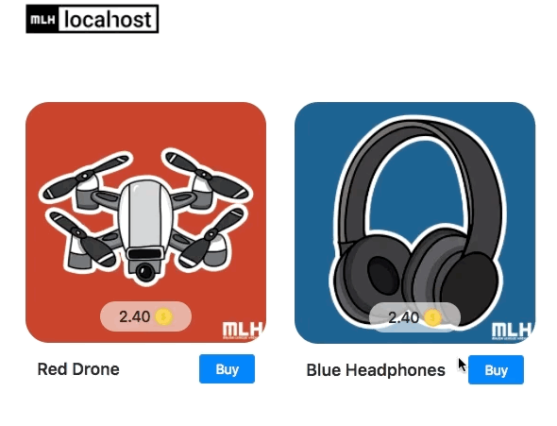
What’s wrong?
The Sell function doesn't work. We're going to need to fix it. Let's dive into the code!
Notes:
What to Say:
Read the slide.

Slide 53
Stop Your Environment
Instructions
In the tab where you ran the npm commands, enter the command below.
What do these commands do?
Line 1: Stops running the local server.
1
2
3
4
5
6
7
8
9
10
11
$ [CTRL] C
$
Notes:
What to Say:
Read the slide.
What to Do:
Wait for everyone to stop the application.

Slide 55
Dive into the Code!
In order to figure out what's wrong, we're going to need to dive into the code for the application. Let's open the code in a text editor.
Instructions
In the tab where you ran the npm commands, enter the command below.
What does this command do?
Line 1: Checks to make sure we're in the right directory.
Line 5: Opens the current directory in Atom.
1
2
3
4
5
6
7
$ pwd
/Users/yourName/Downloads/mlh-localhost-tech-marketplace-master
$ atom .
Notes:
What to Say:
Read the slide.
What to Do:
Wait for everyone to stop the application.

Slide 56
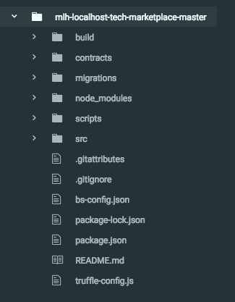
File Structure
Go back to your text editor and open the TechMarketplace code you downloaded, if it’s not open already.
The project folder has several folders inside of it:
contracts/
migrations/
Notes:
What to Say:
Explain that we have to dive into the code to understand what went wrong in the previous section.
What to Do:
Wait for everyone to get on the right screen. Ask if anyone needs help, and encourage participants to help each other find the right location.

Slide 57
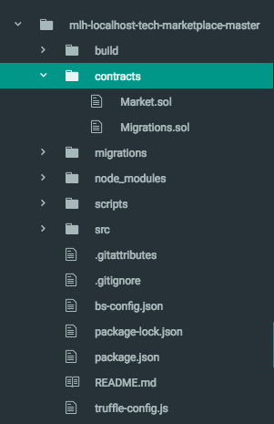
File Structure
contracts/ has two files inside of it:
Market.sol
Migrations.sol
The .sol file ending means these files are written in Solidity.
Notes:
What to Say:
Read the slide.
What to Do:
Wait for everyone to have the right files open.

Slide 58

What is Solidity?
Solidity is the "Contract-Oriented" Programming Language.
It was written specifically for making Smart Contracts.
Solidity is influenced by C++, JavaScript, and Python.
You can find the solidity documentation at mlhlocal.host/solidity-docs
Notes:
What to Say:
Read the slide.
What to Do:
Ask if anyone has experience writing Smart Contracts or working with Solidity before this workshop.

Slide 59

What is a Smart Contract?
A Smart Contract is a contract that both sets up the terms of an agreement (like a transaction) and also enforces those terms.
Smart Contracts are necessary to complete transactions in the Quorum network.
In the next few slides, we'll learn about the structure of a Smart Contract.
Notes:
What to Say:
Read the slide.

Slide 60
Hello, Solidity!
The first program we usually write in a new language is “Hello, World”, which just prints those words.
01
02
03
04
05
06
07
08
pragma solidity ^0.4.11;
contract helloWorld {
function renderHelloWorld() returns (string) {
return 'Hello World':
}
}
What is this code doing?
Line 1: Specifies the version of Solidity.
Line 3: Creates a new contract called helloWorld.
Line 4: Declares a function named renderHelloWorld that takes no parameters and returns a string.
Line 5: returns the string "Hello World"
Notes:
What to Say:
Read the slide.
Let them know that they won't be coding this part along with you; you're just explaining the basic structure of a Smart Contract, which they will be working with. This file does NOT exist in the code they downloaded.

Slide 61
Data Types in Solidity
Smart Contracts require a few data types.
address
Smart Contracts rely on addresses for transactions. The address data type holds a 20 byte value (the size of an Ethereum address).
uint
Unsigned integers up to 256 bits.
string
Data type containing text.
struct
A struct is a custom-defined type that can include other data types listed here.
Notes:
What to Say:
Read the slide.
They will see all of these data types in the Smart Contract they're going to interact with.

Slide 62
Code Review: Market.sol Part I
Market.Sol is a Smart Contract.
What is this code doing?
Line 3: declares a new contract named Market
Line 4: declares an array, Item, that changes size, filled with items
Line 5: declares a state variable that stores a uint256 for each possible address
03
04
05
06
07
08
09
10
11
12
13
contract Market {
Item[] public items;
mapping(address => uint256) public balances;
struct Item {
address owner;
string name;
string image;
uint256 price;
string nickname;
}
Notes:
What to Say:
Read the slide.
What to Do:
Make sure that participants know that you are now looking at code that is in the package they downloaded and that they should have Market.Sol open in their text editor.

Slide 63
Code Review: Market.sol Part II
What is this code doing?
Line 7: declares a new struct (a custom object) called Item
Line 8: gives each Item a variable named owner of type address
Line 9: gives each Item a variable named name of type string
03
04
05
06
07
08
09
10
11
12
13
contract Market {
Item[] public items;
mapping(address => uint256) public balances;
struct Item {
address owner;
string name;
string image;
uint256 price;
string nickname;
}
03
04
05
06
07
08
09
10
11
12
13
contract Market {
Item[] public items;
mapping(address => uint256) public balances;
struct Item {
address owner;
string name;
string image;
uint256 price;
string nickname;
}
Notes:
What to Say:
Read the slide.
What to Do:
If there are participants that feel comfortable reading the slides or explaining the code, feel free to let them do that. Be open to questions if they have them. It's okay if you don't know the answer - someone in the audience might!

Slide 64
Code Review: Market.sol Part III
What is this code doing?
Line 10: gives each Item a variable named image of type string
Line 11: gives each Item a variable named price of type uint256
Line 12: gives each Item a variable named nickname of type string
03
04
05
06
07
08
09
10
11
12
13
contract Market {
Item[] public items;
mapping(address => uint256) public balances;
struct Item {
address owner;
string name;
string image;
uint256 price;
string nickname;
}
03
04
05
06
07
08
09
10
11
12
13
contract Market {
Item[] public items;
mapping(address => uint256) public balances;
struct Item {
address owner;
string name;
string image;
uint256 price;
string nickname;
}
Notes:
What to Say:
Read the slide.
What to Do:
If there are participants that feel comfortable reading the slides or explaining the code, feel free to let them do that. Be open to questions if they have them. It's okay if you don't know the answer - someone in the audience might!

Slide 65
Code Review: Market.sol Part IV
15
16
17
18
19
20
function Market(address nodeA, address nodeB, address nodeC) public {
balances[nodeA] = 10 ether;
balances[nodeB] = 10 ether;
balances[nodeC] = 10 ether;
}
What is this code doing?
Line 15: creates a public function called market that takes three addresses called nodeA, nodeB, and nodeC
Line 16-18: gives each node (participant) a balance of 10 ether
Notes:
What to Say:
Read the slide.
What to Do:
If there are participants that feel comfortable reading the slides or explaining the code, feel free to let them do that. Be open to questions if they have them. It's okay if you don't know the answer - someone in the audience might!

Slide 66
Code Review: Market.sol Part V
31
32
33
34
35
36
37
38
39
40
function buyItem(uint id) public returns (uint) {
require(id >= 0 && id <= items.length);
require(msg.sender != items[id].owner);
require(balances[msg.sender] >= items[id].price);
balances[msg.sender] -= items[id].price;
items[id].owner = msg.sender;
return id;
}
What is this code doing?
Line 31: Declares a public function named buyItem() that takes a uint called id and returns a uint
Line 32: Requires that id be greater than or equal to zero and less than or equal to the length of the items data structure
Notes:
What to Say:
Read the slide.
What to Do:
If there are participants that feel comfortable reading the slides or explaining the code, feel free to let them do that. Be open to questions if they have them. It's okay if you don't know the answer - someone in the audience might!

Slide 67
Code Review: Market.sol Part VI
31
32
33
34
35
36
37
38
39
40
function buyItem(uint id) public returns (uint) {
require(id >= 0 && id <= items.length);
require(msg.sender != items[id].owner);
require(balances[msg.sender] >= items[id].price);
balances[msg.sender] -= items[id].price;
items[id].owner = msg.sender;
return id;
}
What is this code doing?
Line 33: Requires that the message sender (the person buying the item) is not the same as the owner of the item.
Line 34: Requires that the balance of the message sender is greater than or equal to the price of the item being bought
Notes:
What to Say:
Read the slide.
What to Do:
If there are participants that feel comfortable reading the slides or explaining the code, feel free to let them do that. Be open to questions if they have them. It's okay if you don't know the answer - someone in the audience might!

Slide 68
Code Review: Market.sol Part VII
31
32
33
34
35
36
37
38
39
40
function buyItem(uint id) public returns (uint) {
require(id >= 0 && id <= items.length);
require(msg.sender != items[id].owner);
require(balances[msg.sender] >= items[id].price);
balances[msg.sender] -= items[id].price;
items[id].owner = msg.sender;
return id;
}
What is this code doing?
Line 36: Subtracts the cost of the item from the message sender's balance
Line 37: Changes the owner of the item to be the message sender
Line 39: Returns the id if the item purchase.
Notes:
What to Say:
Read the slide.
What to Do:
If there are participants that feel comfortable reading the slides or explaining the code, feel free to let them do that. Be open to questions if they have them. It's okay if you don't know the answer - someone in the audience might!

Slide 69
Your Turn - Write function sellItem()
42
43
44
45
46
47
48
49
50
function sellItem(uint id) public returns (uint) {
require(id >= 0 && id <= items.length);
return id;
}
What should this function do?
1
Require that the message sender is not the owner of the item.
2
Add the price of the item to the balance of the message sender.
3
Delete the owner of the item. (the trickiest part!)
Notes:
What to Say:
Notice that sellItem() is incomplete! That's why you weren't able to sell items running the app locally on your machine.
Read the slide.
What to Do:
Give the participants up to 10 minutes to try to recreate the function based on the buyItem() function and the hints above. Encourage them to help each other. Do NOT move on to the next slide until the majority of the room has attempted to fix the function.
After a few minutes, you can move onto the next slide so that participants can see how to test their code. Encourage participants to take a picture of this slide so they can move back and forth between this slide and testing instructions.

Slide 70
Want to test your code before you see the solution?
Save your changes.
Type the commands below in your terminal.
Navigate back to localhost:3000 in the browser.
Refresh the page, and try to sell something.
If not, type [CTRL] C again and keep trying!
1
2
3
4
5
6
7
8
9
10
11
pwd
mlh-localhost-tech-marketplace-master/
truffle compile
truffle migrate --reset
npm run seed
npm start
Notes:
What to Say:
Explain that these are the steps they can take if they want to test their code as they fill in the function.
What to Do:
Give the participants up to 10 minutes to try to recreate the function based on the buyItem() function and the hints above. Encourage them to help each other.
Participants can check to see if they have it right by saving their changes, typing npm start in the terminal, and refreshing the app in the browser.
Do NOT move on to the next slide until the majority of the room has attempted to fix the function.

Slide 71
Your Turn - Write function sellItem()
Solution
1
Require that the message sender is not the owner of the item.
2
Add the price of the item to the balance of the message sender.
3
Delete the owner of the item.
42
43
44
45
46
47
48
49
50
function sellItem(uint id) public returns (uint) {
require(id >= 0 && id <= items.length);
require(msg.sender == items[id].owner);
return id;
}
Notes:
What to Say:
Read the slide.
What to Do:
Wait for participants to fill in the missing code or compare their code to the solution.

Slide 72
Your Turn - Write function sellItem()
Solution
1
Require that the message sender is not the owner of the item.
2
Add the price of the item to the balance of the message sender.
3
Delete the owner of the item.
42
43
44
45
46
47
48
49
50
function sellItem(uint id) public returns (uint) {
require(id >= 0 && id <= items.length);
require(msg.sender == items[id].owner);
balances[msg.sender] += items[id].price;
return id;
}
Notes:
What to Say:
Read the slide.
What to Do:
Wait for participants to fill in the missing code or compare their code to the solution.

Slide 73
Your Turn - Write function sellItem()
Solution
1
Require that the message sender is not the owner of the item.
2
Add the price of the item to the balance of the message sender.
3
Delete the owner of the item.
42
43
44
45
46
47
48
49
50
function sellItem(uint id) public returns (uint) {
require(id >= 0 && id <= items.length);
require(msg.sender == items[id].owner);
balances[msg.sender] += items[id].price;
delete items[id].owner;
return id;
}
Notes:
What to Say:
Read the slide.
What to Do:
Wait for participants to fill in the missing code or compare their code to the solution.

Slide 74
Our Code is Complete!
Now that our code is complete, let's try running our app again!
42
43
44
45
46
47
48
49
50
function sellItem(uint id) public returns (uint) {
require(id >= 0 && id <= items.length);
require(msg.sender == items[id].owner);
balances[msg.sender] += items[id].price;
delete items[id].owner;
return id;
}
Notes:
What to Say:
Read the slide.
What to Do:
Make sure that everyone has the complete solution before moving on to the next step. Encourage participants to work together.

Slide 75
Run the Application
Instructions
Make sure you are in the mlh-localhost-tech-marketplace-master/ directory.
Type the following commands in your Terminal.
1
2
3
4
5
6
7
8
9
10
11
pwd
mlh-localhost-tech-marketplace-master/
truffle compile
truffle migrate --reset
npm run seed
npm start
Notes:
What to Say:
Read the slide.
What to Do:
Wait for participants to fill in the missing code or compare their code to the solution.
Problems during truffle migrate/start? Ensure that Ethereum client is running in Docker.

Slide 76
Now It Should Work!
localhost:3000
Notes:
What to Say:
Read the slide.
What to Do:
Give the participants some time to interact with the working application.

Slide 78
Let’s recap quickly...
Quorum is an advanced blockchain network developed by engineers at JPMorgan Chase that allows private transactions.
1
2
Solidity is a language used for writing smart contracts.
3
Decentralized applications allow for public verification of transactions.
Notes:
What to Say:
Read the slide.

Slide 79
What did you learn today?
We created a fun quiz to test your knowledge and see what you learned from this workshop.
http://mlhlocal.host/quiz
Notes:
What to Say:
Read the slide.
What to Do:
Get participants excited about taking the quiz. Encourage them all to take it, and pass out stickers to participants who earn 100s. Also encourage participants to take the survey - let them know that Localhost takes their feedback very seriously and we use their feedback to make the workshop better for future participants.

Slide 81
Technology Careers at J.P. Morgan
Did you enjoy learning about Quorum®? Check out technology careers at J.P. Morgan!
http://mlhlocal.host/jpmorgan-careers
When you join the technology team at J.P. Morgan, you're not just working at a global financial institution. You're part of a company that is changing the way people bank, thanks to a $9.5B+ annual technology investment. Our diverse global team of 40,000+ technologists works together to design, build, and deploy everything from enterprise technology initiatives to big data and mobile applications. With them, you'll drive innovations in areas like electronic payments, cybersecurity, machine learning, and cloud development. Start your career today!
Notes:
What to Say:
Read the slide.

Slide 82
Where to go from here...
Visit the Quorum Wiki to learn more.
1
2
After you get comfortable, submit issues to the Quorum repo.
3
Want to work on Quorum professionally? Check out careers at J.P. Morgan!
Notes:
What to Say:
Read the slide.
What to Do:
Let participants know that you're wrapping up.

Slide 83
Keep Learning: Practice Problems for Later
Extra Practice Problem 1:
Add a changePrice() function to Market.sol. This function should allow the owner of an item on the marketplace to change its price.
Extra Practice Problem 2:
Review the open issues at mlhlocal.host/quorum-issues and try to solve one of them on your own computer!
Notes:
What to Say:
Read the slide.
What to Do:
Encourage participants to try these problems on their own.

Slide 84
Notes:
What to Say:
Thank everyone for coming!

